Slide 1


A Study to Sentiment Analysis on Text-Based Product Review

Slide 2

Presented By
Minul Islam 170204029
Mohammad Najrul Islam 170204061
Tasmia Ahmed 170204092
Nafisa Khan 170204103
Supervised By
Ms. Qamrun Nahar Eity
Assistant Professor
Department of Computer Science and Engineering
Ahsanullah University of Science and Technology

Slide 3








OVERVIEW
Introduction
Methodology
Motivation
Result Analysis
Literature Review
Future Work
Data Visualization
Conclusion

Slide 4

1
Strong social platform to share people’s opinion
Major dependency of businesses depends on customer’s opinion
2
Valuable responses from customers impacts on business strategies
3
Introduction
Exploring sentiment analysis under NLP using machine learning methods along with feature extraction and n-gram models
4
5
Comparing accuracy for finding the best possible method

Slide 5

Motivation
Classifies product’s market demand
Analyses product whether good or bad
Affects sellers investment decision
Sellers can analyse customers reviews
Affects customers’ buying decision
Customers’ reliance towards reviews

Slide 6
Literature Review
Author | Title | Method | Dataset | Accuracy
[1] A. Al Shamsi, Arwa & Bayari, Reem & Salloum, Said | Sentiment Analysis in English Texts | The machine learning algorithms i.e Decision Tree, Naïve Bayes, Random Forest, K-NN, ID3 and RandomTree and Texts obtained from tweets | Texts obtained from tweets | Balanced Dataset: Naïve Bayes and ID3 had accuracy level of 97.6%. Unbalanced Dataset: The KNN, Decision Tree, Random Forest and Random Tree classifiers had accuracy level of 82.7%
[2] Dang, Cach & Moreno García, María & De La Prieta, Fernando. | Sentiment Analysis Based on Deep Learning: A Comparative Study | Deep Neural Networks (DNN), Convolutional Neural Networks (CNN) and Recurrent Neural Networks (RNN). | Tweets, books, music and movie reviews | CNN offered better results than RNN. RNN doesn’t perform well when used with TF-IDF
[3] Chandra Sekharan, Sindhu. | Aspect Based Sentiment Analysis of Amazon Product Review | Used n-gram and multinomial Naïve Bayes classifier along with BoW for sentiment classification. | Reviews of products that customers posted online. | Naïve Bayes classifier gives more accuracy with BOW.
[4] Gupta, Ritik & Kumar, Pushpendra & Yadav, Vikash | Sentiment Analysis of Text Data | 5 machine learning algorithms including SVM and TFIDF | Twitter Tweets | Combination of SVM and TF-IDF provided best accuracy level with 96%

Slide 7
Literature Review (Continued)
Author | Title | Method | Dataset | Accuracy
[5] Agarwal, Apoorv & Xie, Boyi & Vovsha, Ilia & Rambow, Owen & Passonneau, Rebecca | Sentimental Analysis on Twitter Data | Unigram model, Tree kernel model, 100 Senti-features Model and two combinations of (Kernel+Sentifeatures) And (Unigram+Sentifeatures) models | Twitter data from a commercial source | Accuracy of (Unigram+ Sentifeatures) model is 60.83% which is more than other used models
[6] Yasen, Mais & Tedmori, Sara | Movies Reviews Sentiment Analysis and Classification. | 8 machine learning Classifiers named NB, BN, DT, KNN, RRL, SVM, RF, and SGD | Movie reviews dataset from IMDB | RF has proved its best efficiency with 96.01%. RRL performed the worst with 79.51% accuracy
[7] Kumari, Upma & Sharma, Arvind & Soni, Dinesh | Sentiment Analysis of Smart Phone Product Review | Used Support Vector Machine (SVM) algorithm | Smartphone reviews collected from Tweets | Achieved 90.99% Accuracy using SVM algorithm
[8] Lim, Wei Lun & Ho, Chiung Ching & Yee, Ting | Tweet sentiment analysis using deep learning with nearby locations as features | Convolutional Neural Network (CNN) | Tweets from twitter & nearby location category | Accuracy of twitter data has been increased after adding location as a feature.

Slide 8
Literature Review (Continued)
Author | Title | Method | Dataset | Accuracy
[9] Sharma, Aditya & Daniels, Alex. | Tweets Sentiment Analysis via Word Embeddings and Machine Learning Techniques | Random Forest was used. For feature selection, Word2vec was compared with BOW & TF-IDF | Tweets of 2019 Indian Election | Word2vec gives highest accuracy of 86.87% compare to BOW and TF-IDF.
[10] Turney, Peter | Thumbs Up or Thumbs Down? Semantic Orientation Applied to Unsupervised Classification of Reviews | Unsupervised learning algorithm which uses PMI-IR to calculate Semantic Orientation | Epinions’ reviews of automobiles, banks, movies, and travel destinations | The accuracy is overall 74% and the range is between 84% for automobile and 66% for movie Reviews
[11] Patodkar, Vaibhavi & I.R, Sheikh | Twitter as a Corpus for Sentiment Analysis and Opinion Mining | Multinomial Naïve Bayes classifier which uses N-gram and POS features. | Collection of tweets from Twitter | Bi-grams achieved the best performance.
[12] Holthoff, Lisa | The Emoji Sentiment Lexicon: Analysing Consumer Emotions in Social Media Communication | Lexicon | 72 brandrelated tweets based on their consumer scenarios were Used | Lexicon method accuracy is not as good as machine learning methods.

Slide 9
Dataset
Dataset of 20474 product review data
Dataset Source:
Repository of Amazon Product Data (2014) - Automotive

Slide 10
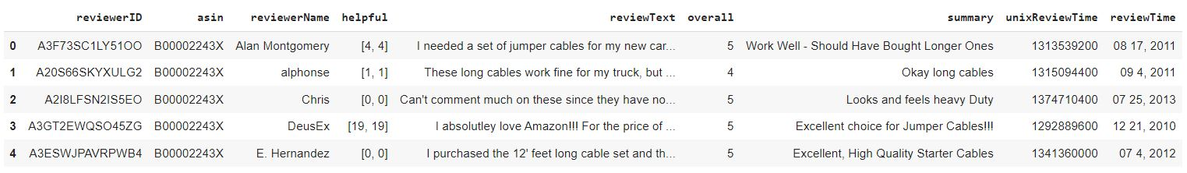
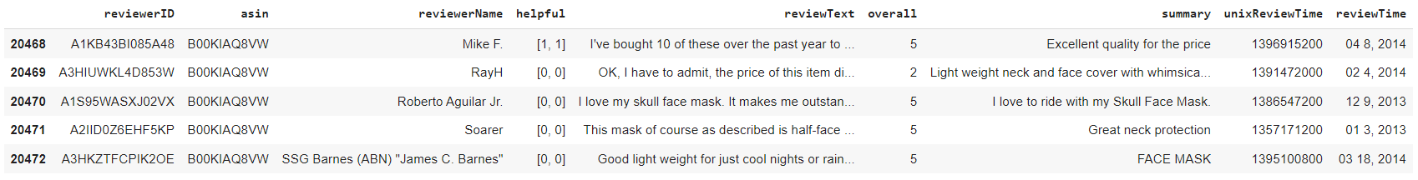
Data Visualization (Continued)
First and Last 5 data rows of the dataset

Slide 11
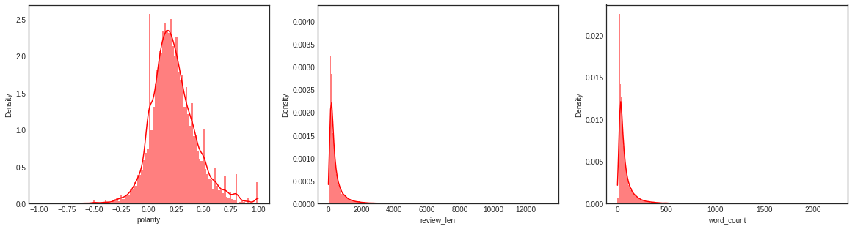
Data Visualization (Continued)
Polarity, Review length and Word count

Slide 12
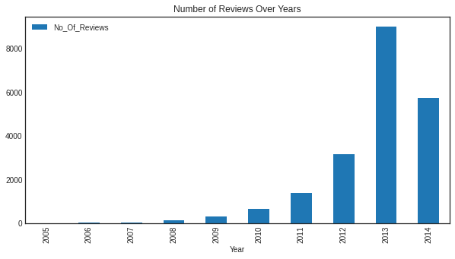
Data Visualization (Continued)
Year based Review Count

Slide 13
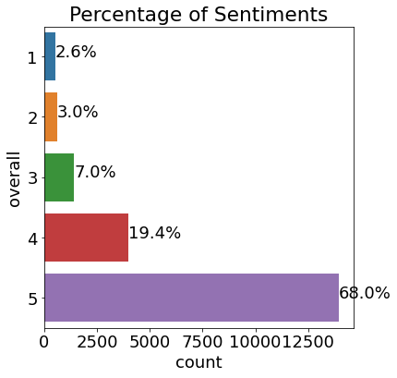
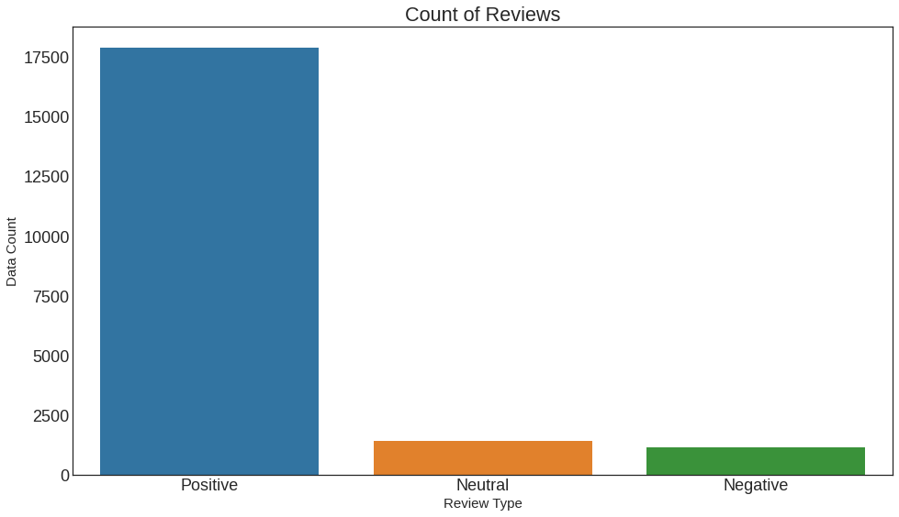
Data Visualization (Continued)
20,473
17,895
Considering:
4,5 as Positive sentiment;
3 as Neutral sentiment;
1,2 as Negative sentiment
1,430
1,148

Slide 14
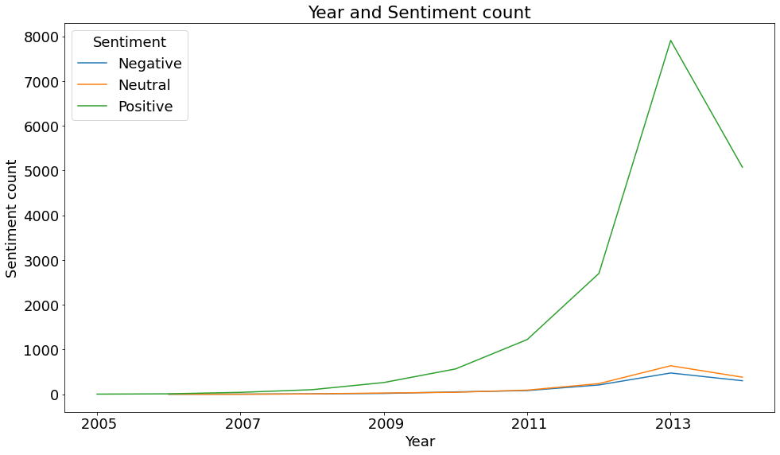
Data Visualization (Continued)
Year based Sentiment Count

Slide 15
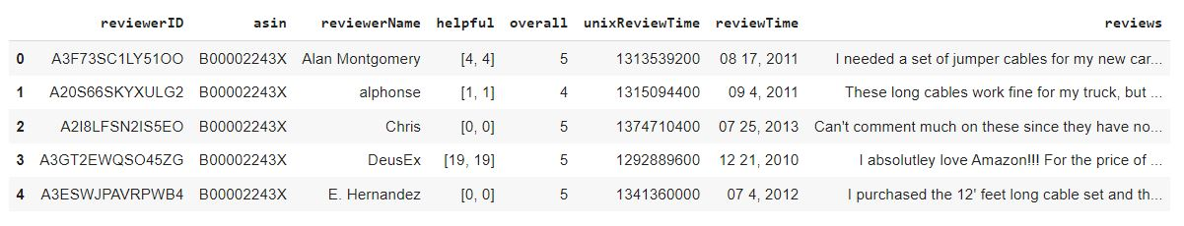
Data Visualization (Continued)
First 5 data rows after joining
‘reviewText’ and ‘summary’ columns as ‘reviews’

Slide 16
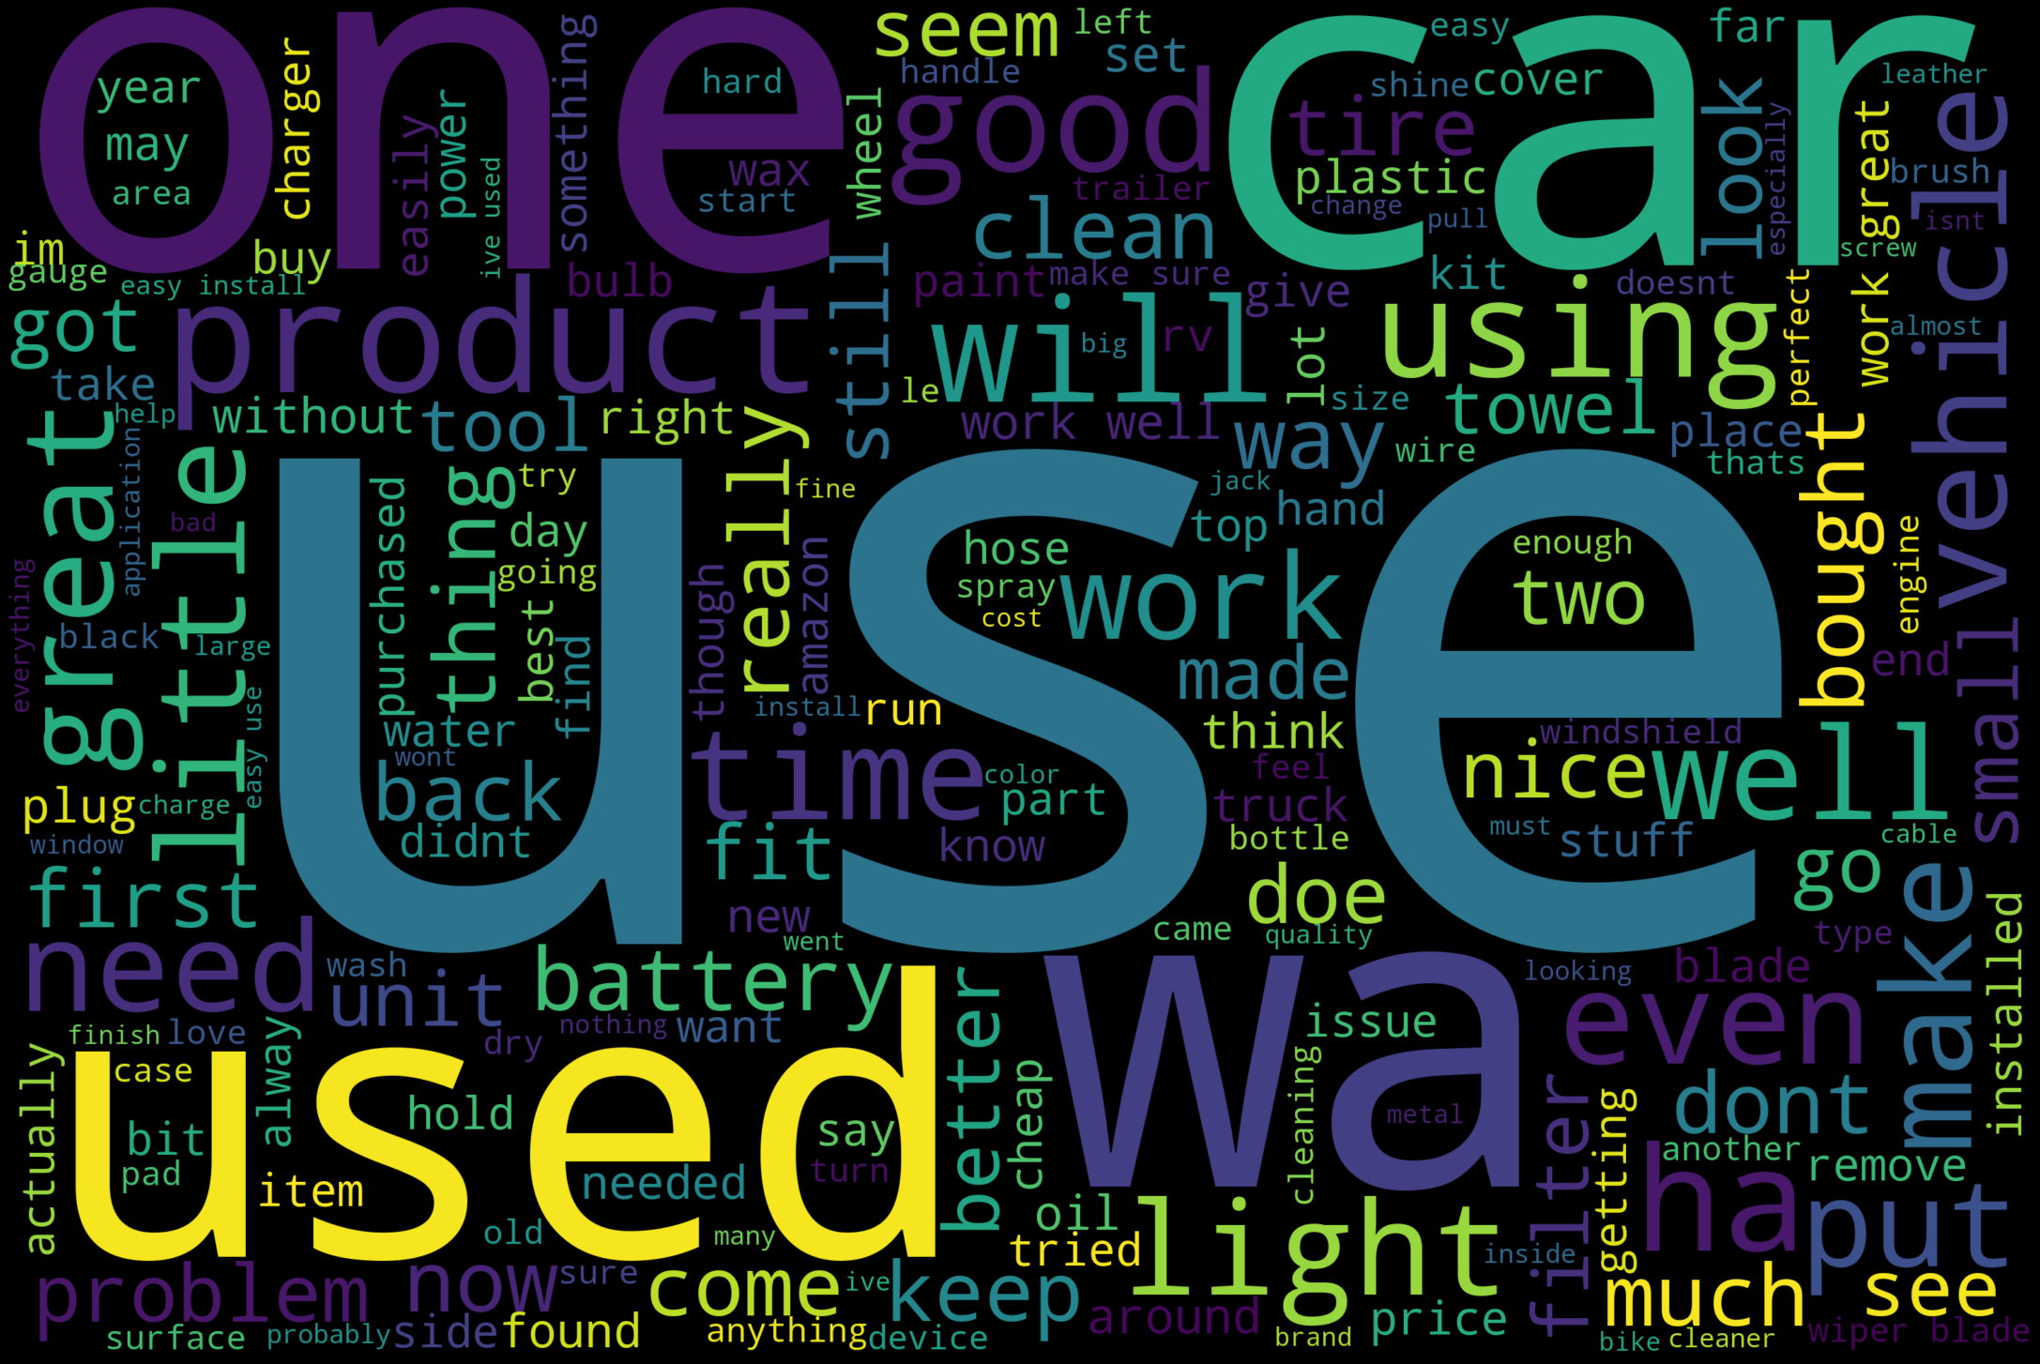
Data Visualization (Continued)
Wordcloud of top words from all the reviews

Slide 17
Methodology
Collecting Reviews from Amazon
Start
Store Data in .json File
Preprocessing Data
One-vs-rest approach
n-gram Models
Training Set
Unigram
BoW
Training Model
Feature Vector
Bigram
TF-IDF
Balancing Data by SMOTE
Applying ML Models
Testing Set
Testing and Analyzing Result
End
Result Comparison with Cross-Validation Score
Result Comparison of Different Models based on Accuracy
Display Result
Figure: Workflow Diagram

Slide 18
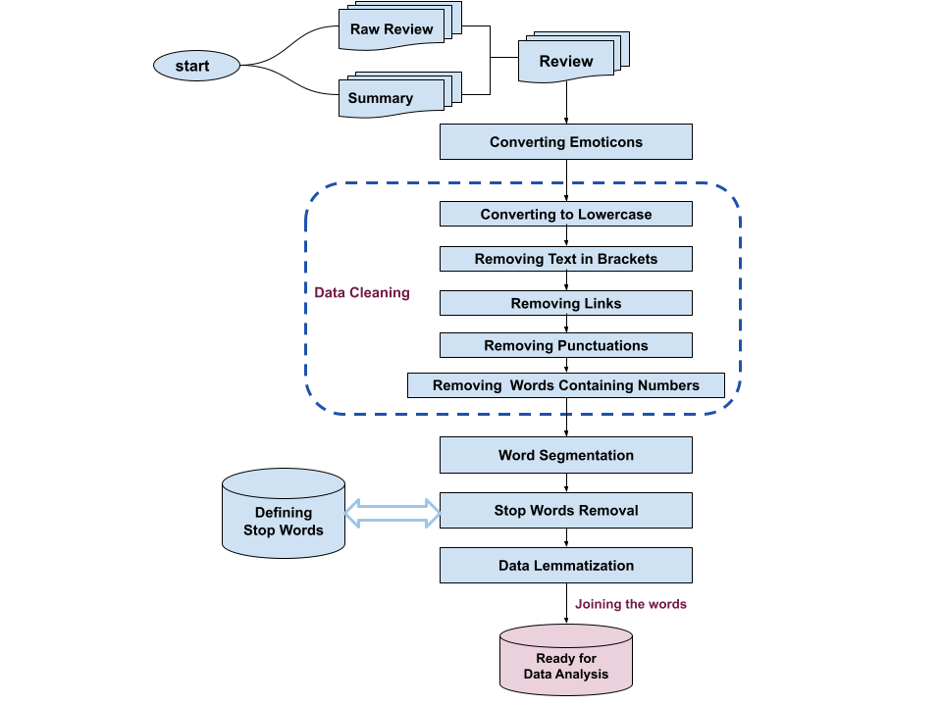
Methodology (Continued)
Preprocessing Data
Figure: Data Preprocessing Diagram

Slide 19
Methodology (Continued)
Preprocessing Data (Continued)
This is a great product(as most CG products are!). :D
Converting emoticons into text
This is a great product(as most CG products are!). grin
Conversion to small letter
this is a great product(as most cg products are!). grin
Removing text in brackets
this is a great product. grin

Slide 20
Methodology (Continued)
Preprocessing Data (Continued)
to make your life easier and perfect use it with a full flow gilmour quick connect. http://www.amazon.com/gp/product/b000xtmgtg
Removing url and links
to make your life easier and perfect use it with a full flow gilmour quick connect.

Slide 21
Methodology (Continued)
Preprocessing Data (Continued)
this cables are not good as expected!!!
Removing Punctuation marks
this cables are not good as expected
Tokenizing
‘this’ ‘cables’ ‘are’ ‘not’ ‘good’ ‘as’ ‘expected’
Removing predefined stopwords
‘cables’ ‘not’ ‘good’ ‘expected’
Lemmatization
‘cable’ ‘not’ ‘good’ ‘expected’
Joining the words
cable not good expected

Slide 22
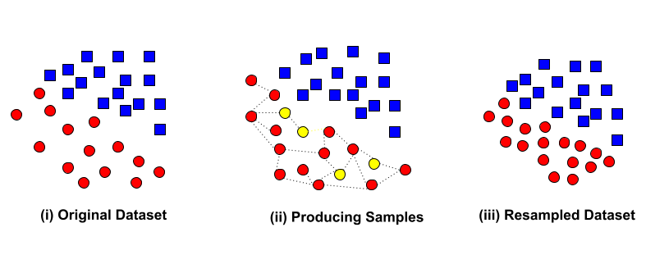
Methodology (Continued)
SMOTE: Synthetic Minority Oversampling Technique

Slide 23

Methodology (Continued)
Dataset Splitting
Split into two sets.
Training and testing sets.

Slide 24
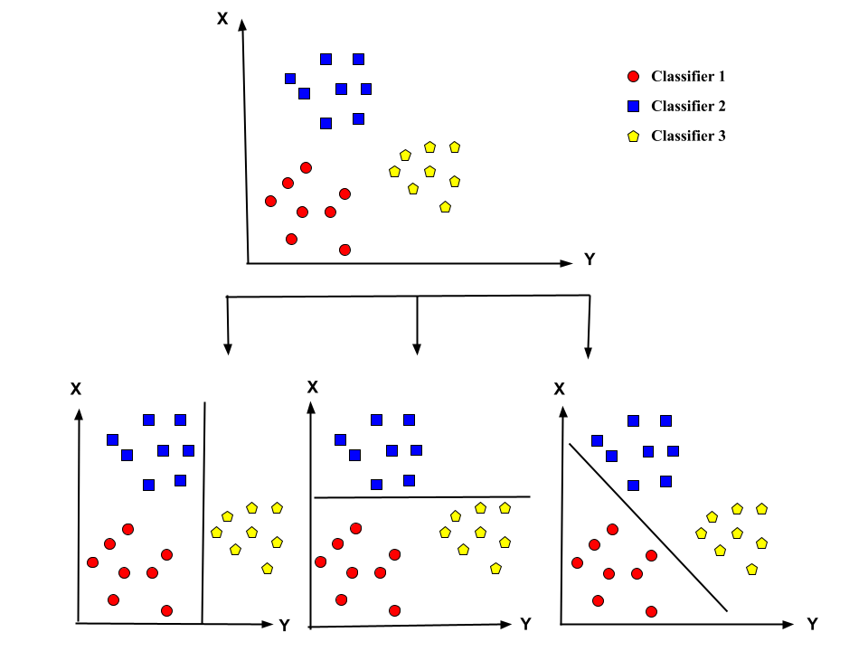
Methodology (Continued)
One-vs-rest Classification

Slide 25
Methodology (Continued)
N-gram Language Model
Machine Learning Algorithms
Feature Extraction Models
Naïve Bayes
Logistic Regression
K-Nearest Neighbors
Support Vector Machine
Random Forest
Bag of Words (BoW)
Term Frequency-Inverse Document (TF-IDF)
Unigram
Bigram

Slide 26
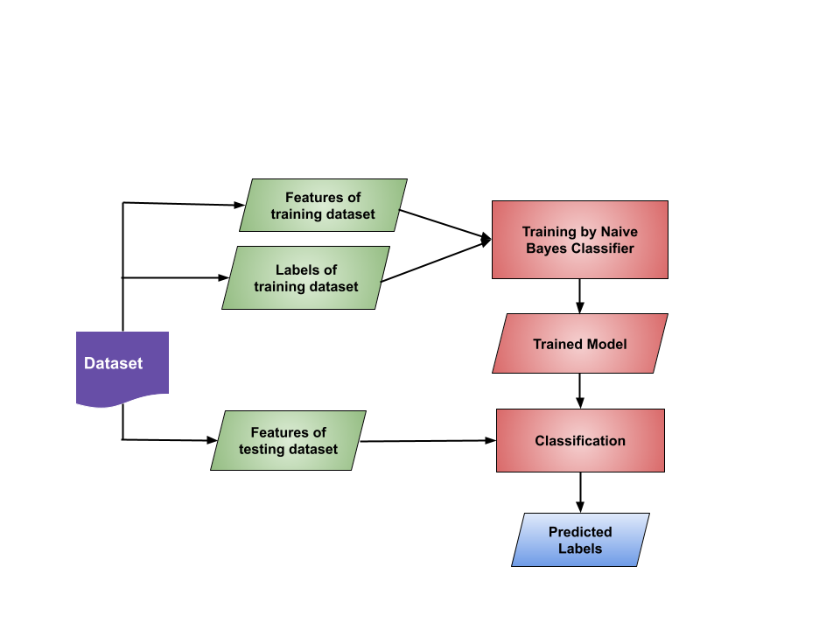
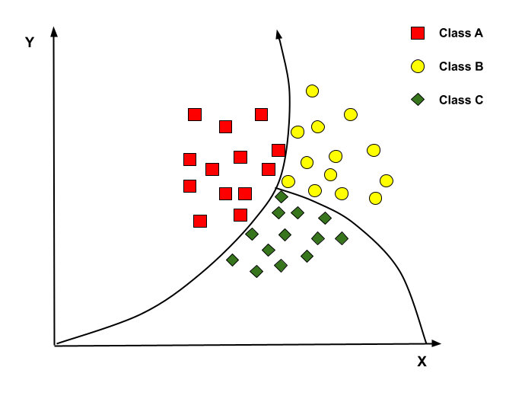
Methodology (Continued)
Naïve Bayes

Slide 27
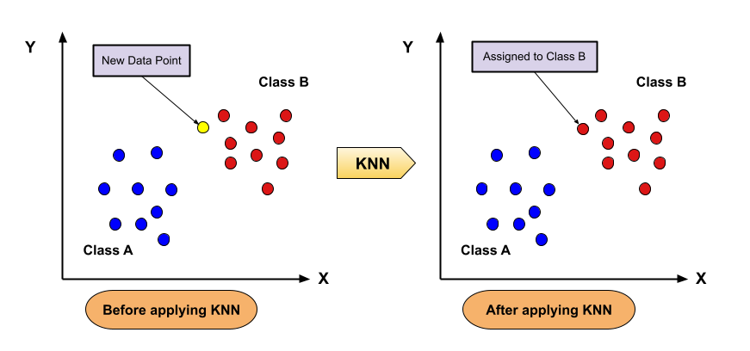
Methodology (Continued)
K-Nearest Neighbors

Slide 28
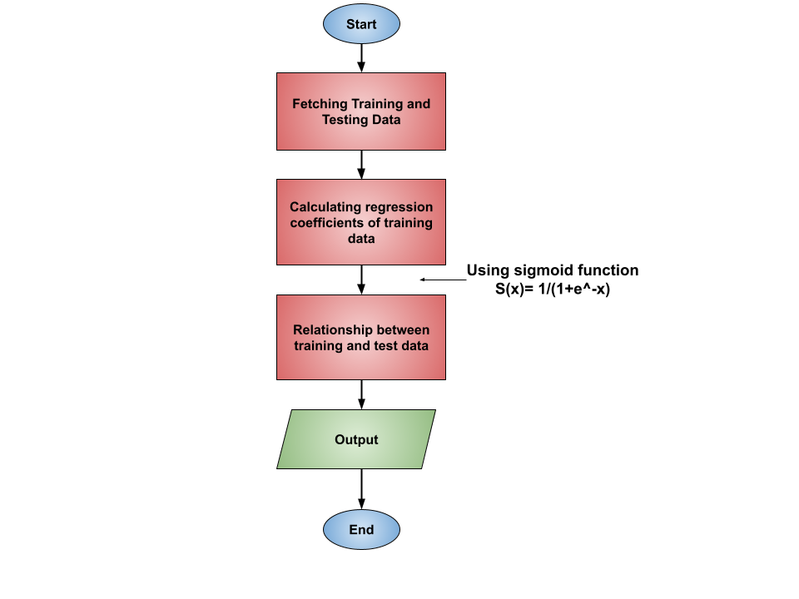
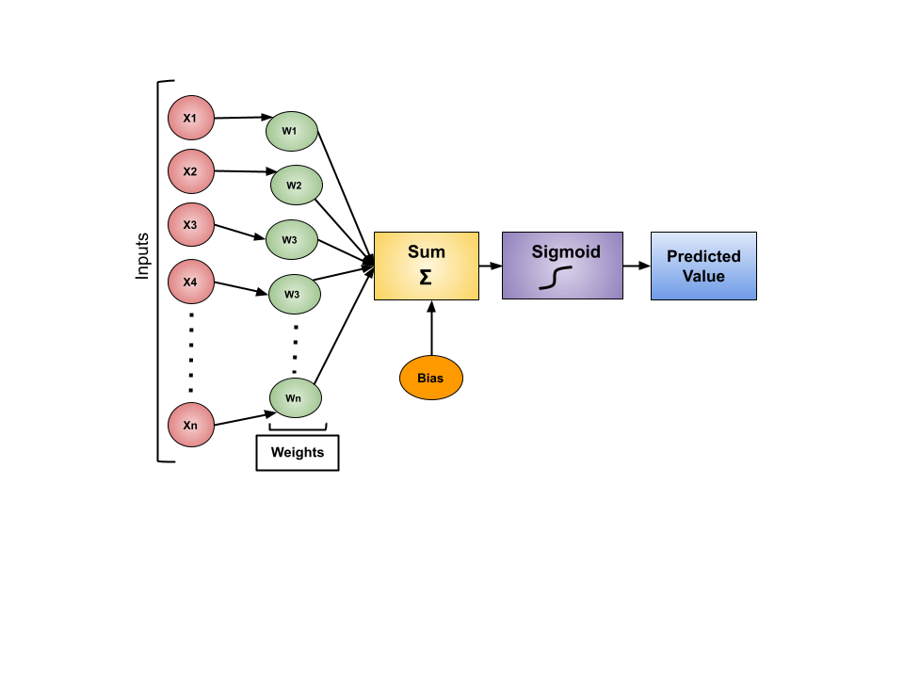
Methodology (Continued)
Logistic Regression

Slide 29
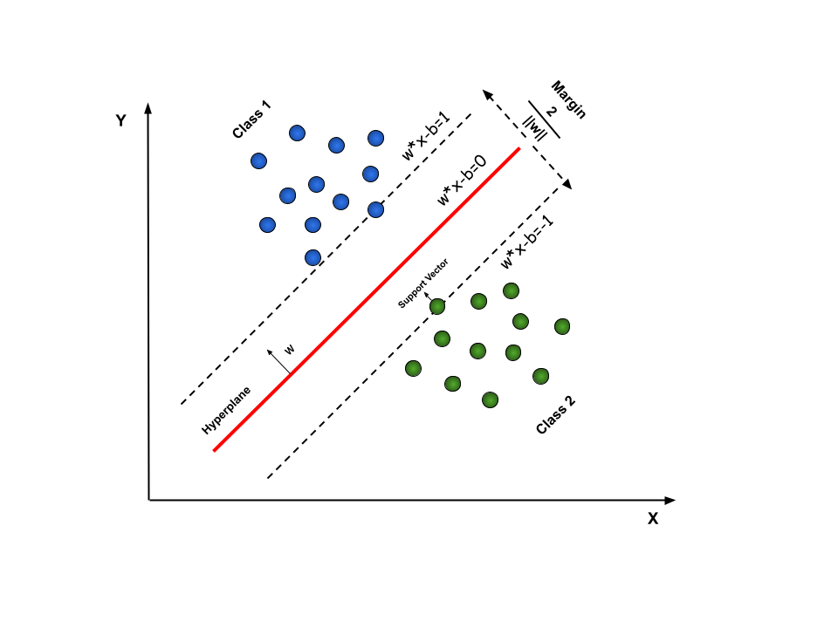
Methodology (Continued)
Support Vector Machine

Slide 30
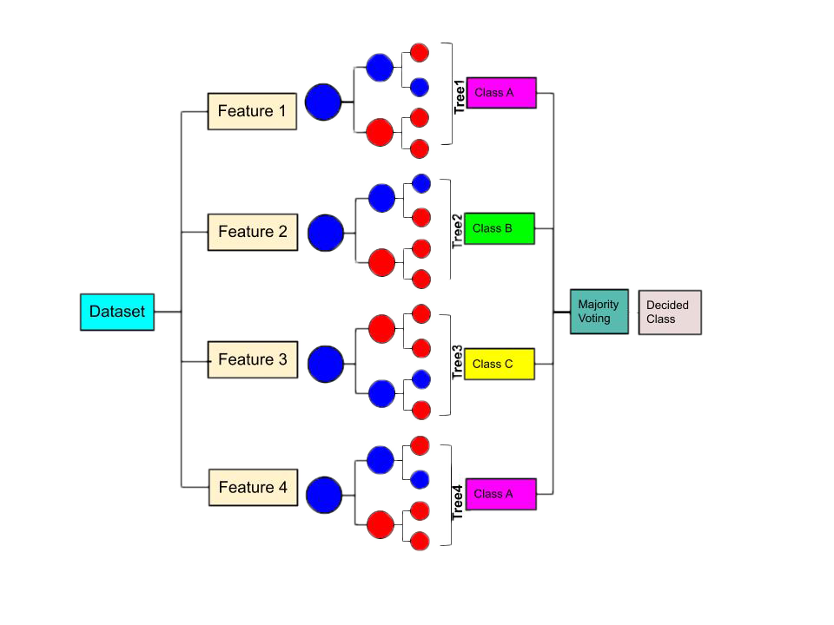
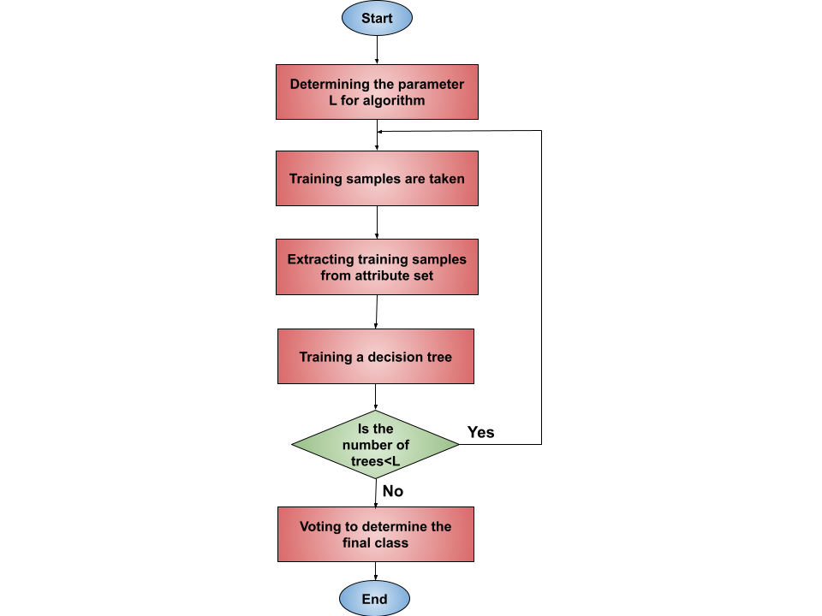
Methodology (Continued)
Random Forest

Slide 31
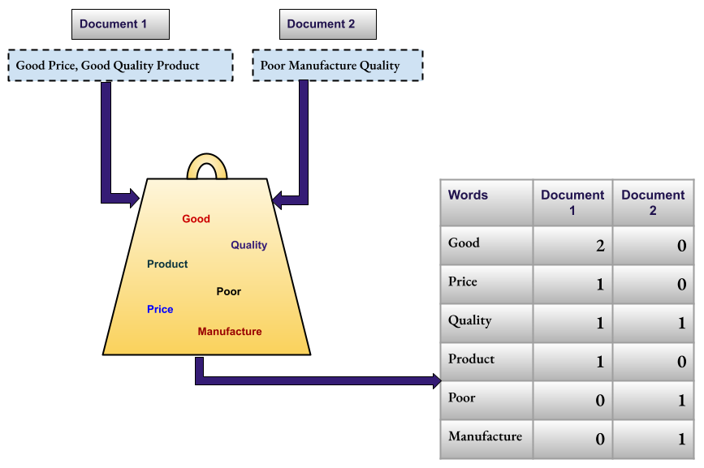
Methodology (Continued)
Feature Extraction Model : BOW

Slide 32
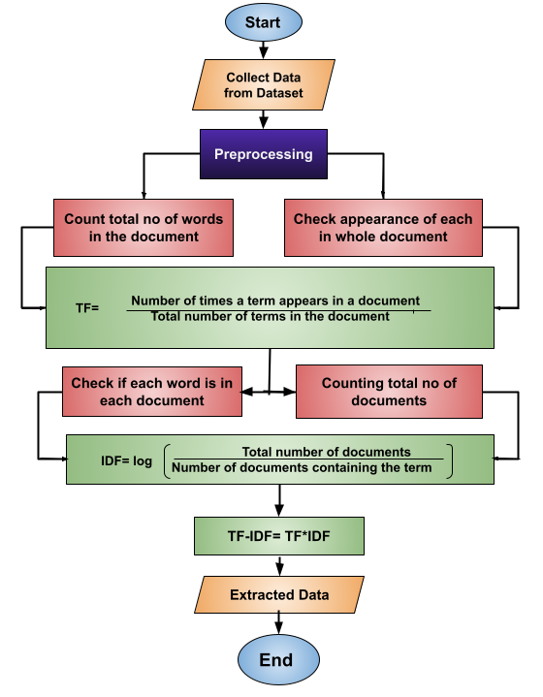
Methodology (Continued)
Feature Extraction Model : TF-IDF

Slide 33
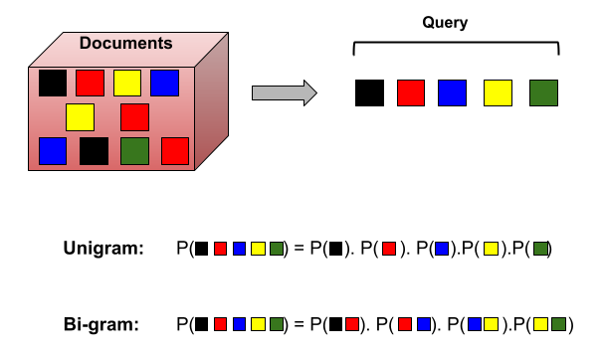
Methodology (Continued)
N-gram Language Model

Slide 34
Result Analysis

Slide 35
Result Analysis (Continued)

Slide 36
Result Analysis (Continued)

Slide 37
Result Analysis (Continued)

Slide 38
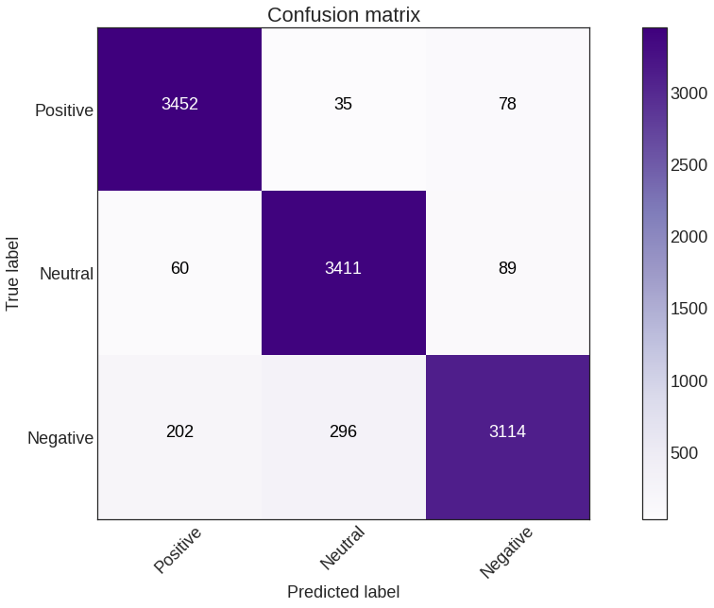
Result Analysis (Continued)
Best Model-1: Random Forest + TF-IDF with Bigram
Accuracy
Precision
Recall
F1 Score
93.65%
93.76%
93.68%
93.59%

Slide 39
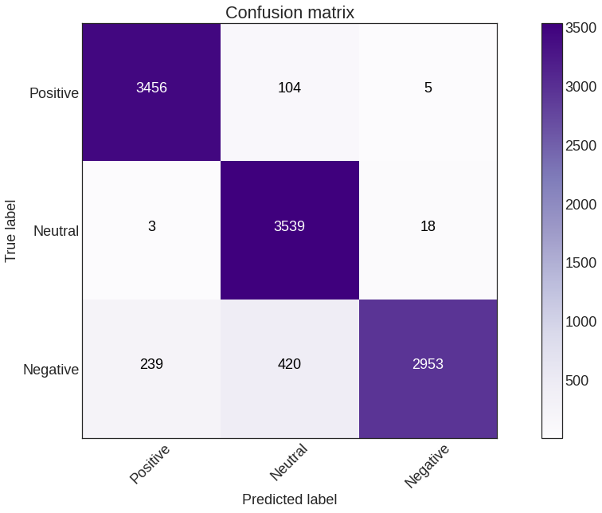
Result Analysis (Continued)
Best Model-2: Logistic Regression + TF-IDF with Bigram
Accuracy
Precision
Recall
F1 Score
92.91%
93.43%
92.97%
92.77%

Slide 40
Future Work
To use more advanced and deep learning models to increase the accuracy
Create dataset for Bengali reviews and then analyze
the sentiments from it.
More Advanced Models
New Dataset

Slide 41
Conclusion
Sentiment Detection
Customers sentiment will be detected from their reviews.
Sentiment analysis detected through applying the different combinations of feature extraction techniques with ML models.
Apply Models
Experiment
Effective text preprocessing and balancing is done on the dataset.
Experiment is done using same dataset on the combinations of models.
Accuracy comparison helps to determine the best model of all.
Here, ‘’TF-IDF with Bigram + Random Forest’’ gives 94% accuracy.
Compare Models

Slide 42
References
[1] Arwa Alshamsi, Reem Bayari, Said Salloum, et al. Sentiment analysis in English texts. Advances in Science, Technology and Engineering Systems Journal, 5(6):1683–1689, 2020.
[2] Nhan Cach Dang, María N Moreno-García, and Fernando De la Prieta. Sentiment analysis based on deep learning: A comparative study. Electronics, 9(3):483, 2020.
[3] C Sindhu, Swapneel Niraj Deo, Yash Mukati, Gona Sravanthi, and Shubhranshu Malhotra. Aspect based sentiment analysis of amazon product reviews. International Journal of Pure and Applied Mathematics, 118(22):151–157, 2018.
[4] RITIK GUPTA, PUSHPENDRA KUMAR, and VIKASH YADAV. Sentimental analysis on text data. 2021.
[5] Apoorv Agarwal, Boyi Xie, Ilia Vovsha, Owen Rambow, and Rebecca Passonneau. 2011. sentiment analysis of twitter data. In In Proceedings of the Workshop on Languages in Social Media, LSM’11. Citeseer.
[6] Mais Yasen and Sara Tedmori. Movies reviews sentiment analysis and classification. In 2019 IEEE Jordan International Joint Conference on Electrical Engineering and Information Technology (JEEIT), pages 860–865. IEEE, 2019.
[7] Upma Kumari, Arvind K Sharma, and Dinesh Soni. Sentiment analysis of smart phone product review using svm classification technique. In 2017 International Conference on Energy, Communication, Data Analytics and Soft Computing (ICECDS), pages 1469–1474. IEEE, 2017.

Slide 43
References (Continued)
[8] Wei Lun Lim, Chiung Ching Ho, and Choo-Yee Ting. Tweet sentiment analysis using deep learning with nearby locations as features. In Computational Science and Technology, pages 291–299. Springer, 2020.
[9] Aditya Sharma and Alex Daniels. Tweets sentiment analysis via word embeddings and machine learning techniques. arXiv preprint arXiv:2007.04303, 2020.
[10] LM Chiappe. Pd turney. thumbs up or thumbs down?: semantic orientation applied to unsupervised classification of reviews. in acl’02: Proceedings of the 40th annual meeting on association for computational linguistics, pages 417–424, morristown, nj, usa, 2001. ass. Society, 12(3):344–350, 2010.
[11] PP Alexander Pak. Twitter as a corpus for sentiment analysis and opinion mining. In Conference: Proceedings of the International Conference on Language Resources and Evaluation, LREC 2010, 2010.
[12] Lisa Holthoff. The emoji sentiment lexicon: Analysing consumer emotions in social media communication. In 49th European Marketing Academy (EMAC) Annual Conference, 2020.
[13] Julian McAuley. Amazon product reviews, 2014. http://jmcauley.ucsd.edu/data/amazon/index_2014.html

Slide 44


for your attention.
Any Questions?

